Slide 1





Sweet Harvest Run
Caitlyn Lefebvre & Isabella Hamilton

Slide 2


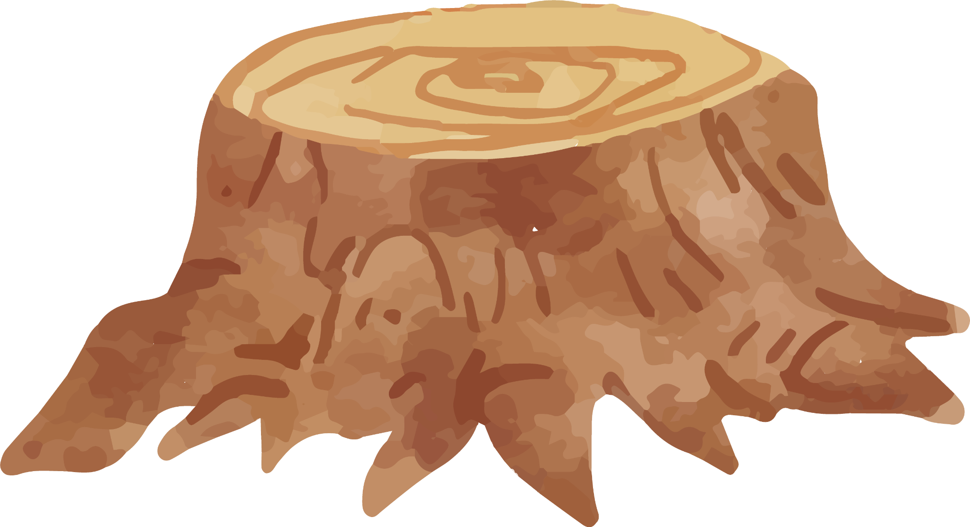

Background & Motivation
We took inspiration from Caitlyn’s game proposal for Assignment 2 but made some adjustments to simplify the concept and make it more suitable as a 2D game for beginner developers.
We love fall!
We want to create a fun, seasonal game
Leaves opportunity to develop different (seasonal) versions

Slide 3



Target Users
Children 8+ (but designed to be fun and engaging for players of all ages)

Slide 4


Context/Game World
Set during the fall season
Inside a large, winding corn maze
Playful and festive atmosphere
Obstacles and hidden pieces of candy corn

Slide 5
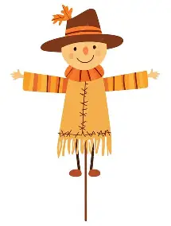

Characters & Plot
Main Character: The Scarecrow (Player)
Antagonist: Time
The player controls the scarecrow whose mission is to collect candy corn and escape the corn maze before time runs out
There is no physical enemy in the game; instead the challenge comes from racing against the clock

Slide 6
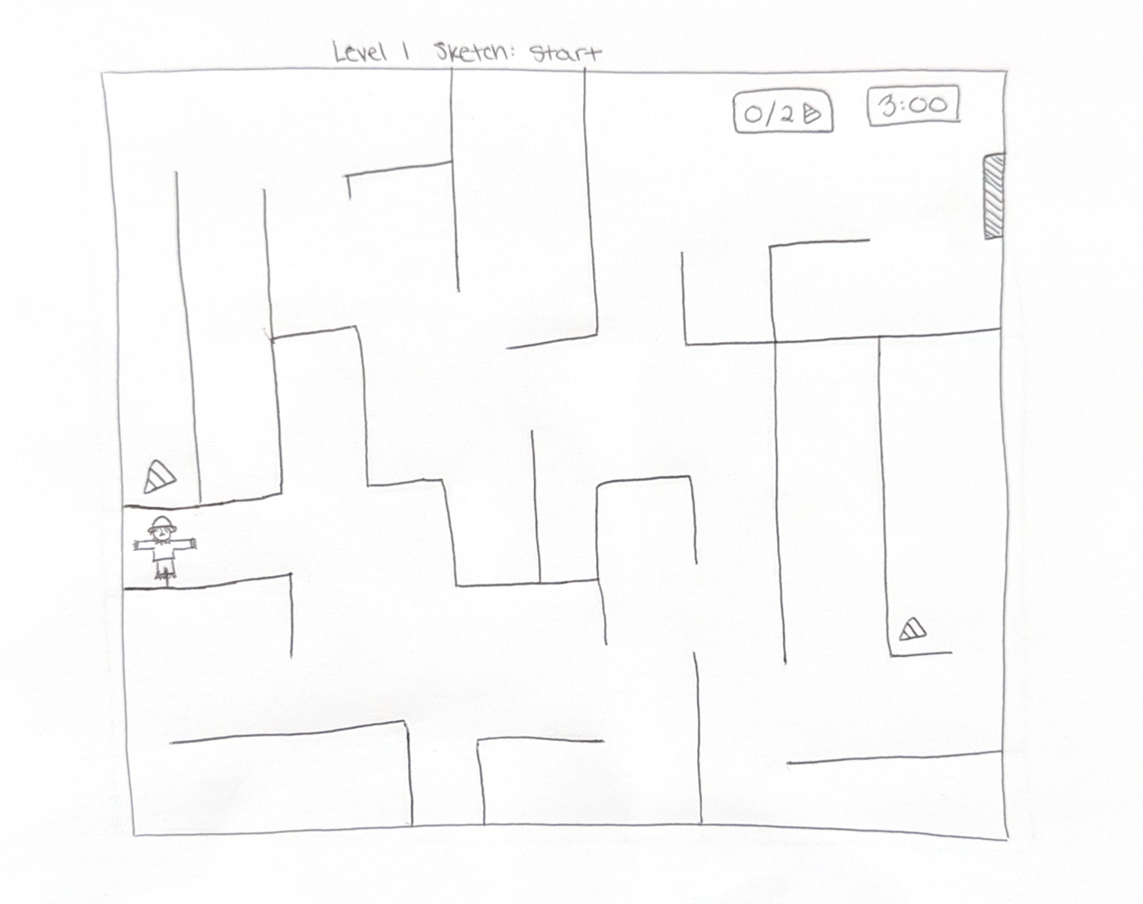
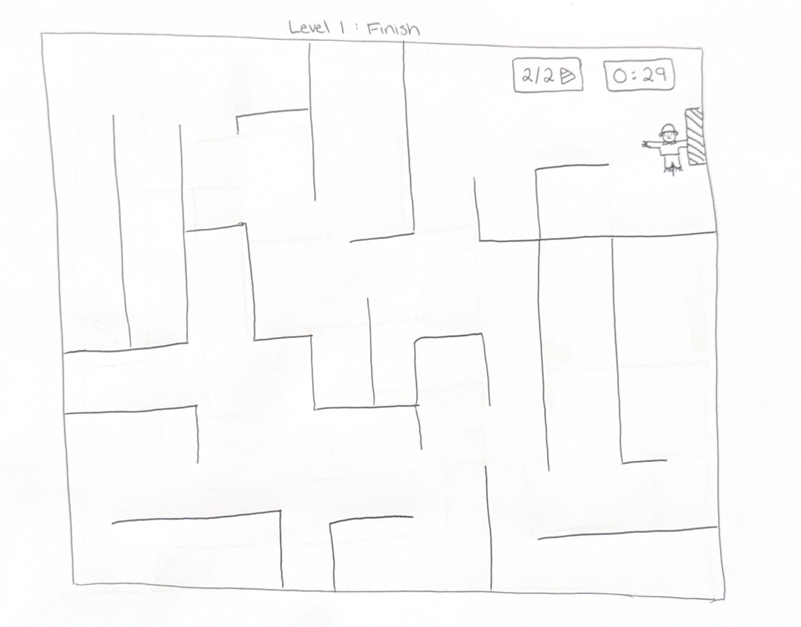
Rough Sketch

Slide 7
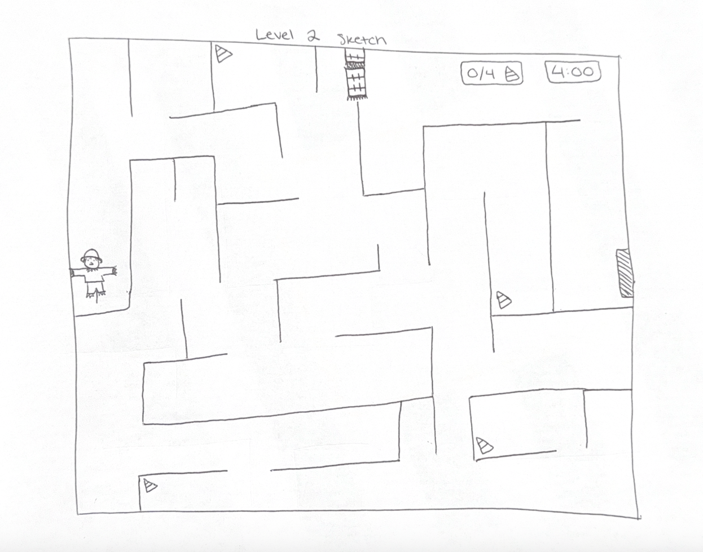
Rough Sketch

Slide 8
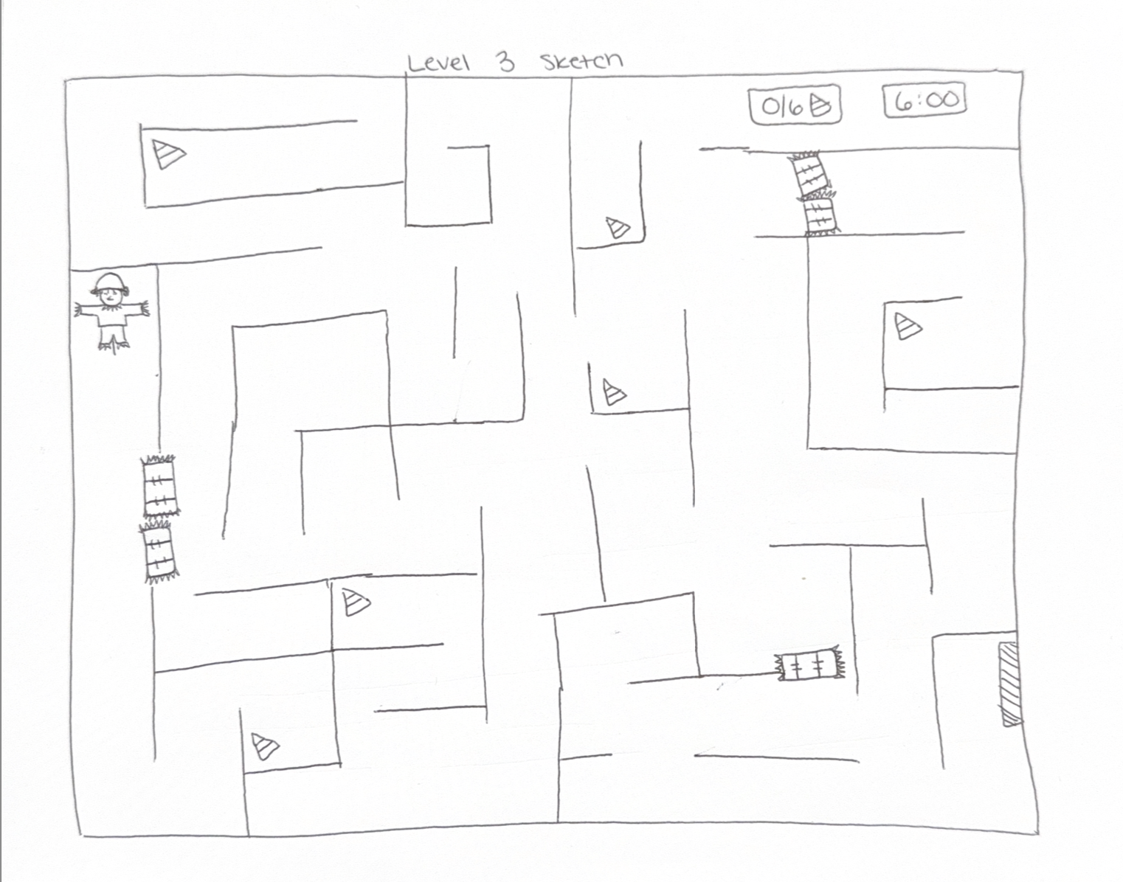
Rough Sketch

Slide 9
Rules of the Game
01
02
03
04
Collect all the pieces of candy corn in each level
Escape each level before time runs out
Players must avoid/overcome obstacles that may slow them down or block their path
Levels increase in difficulty with more complex mazes and harder-to-find candy corn

Slide 10




Controls
Arrow keys
“C” key
Move the Scarecrow in the respective direction
Collect pieces of candy corn
Space bar
Jump over obstacles

Slide 11


Distribution
Caitlyn
Isabella
Story writer
Programmer
Artist
Programmer

Slide 12
Thanks!
Do you have any questions?

